Slide 1
MPA- and Length-Based Methods
Dr. Jim Berkson

Slide 2
MPA-Based Methods
McGilliard et al. 2011

Slide 3
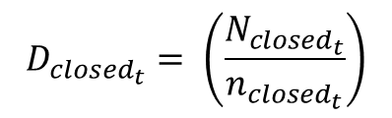
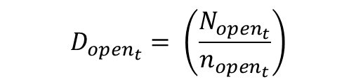
$$D_{{open}_{t}}= \left(\frac{N_{{open}_{t}}}{n_{{open}_{t}}}\right)$$
$$D_{{closed}_{t}}= \left(\frac{N_{{closed}_{t}}}{n_{{closed}_{t}}}\right)$$
where:
$$D_{{open}_{t }} is the density in the open area at time t$$
$$N_{{open}_{t}} is the abundance in the open area at time t$$
$$n_{{open}_{t}} is the size of the open area at time t$$

Slide 4
Control rule based

Slide 5
The closer the density outside the MPA is to the density inside the MPA, the greater the fishing effort outside the MPA can be.
If the density outside the MPA has been fished down, then the effort should decrease allowing the population to rebuild.

Slide 6
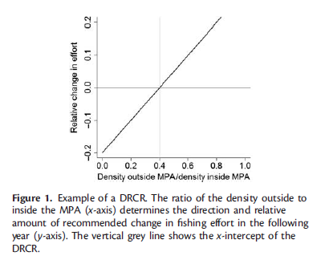

Slide 7
Sensitive to movement patterns of adults and larvae and survey variability.
Need time to allow the impact of the MPA to stabilize.

Slide 8
Length-Based Methods

Slide 9
Froese 2004 (the simple, common sense approach) 3 indicators
Percentage of mature fish in the catch (target = 100%)
“Let them spawn!”
Percent of specimens with optimum length in catch (target = 100%)
Number of fish in unfished year class multiplied by their mean individual weight is maximized.
“Let them grow!”
Percentage of “mega-spawners” in catch (target = 0%)
“Let the mega-spawners live!”

Slide 10
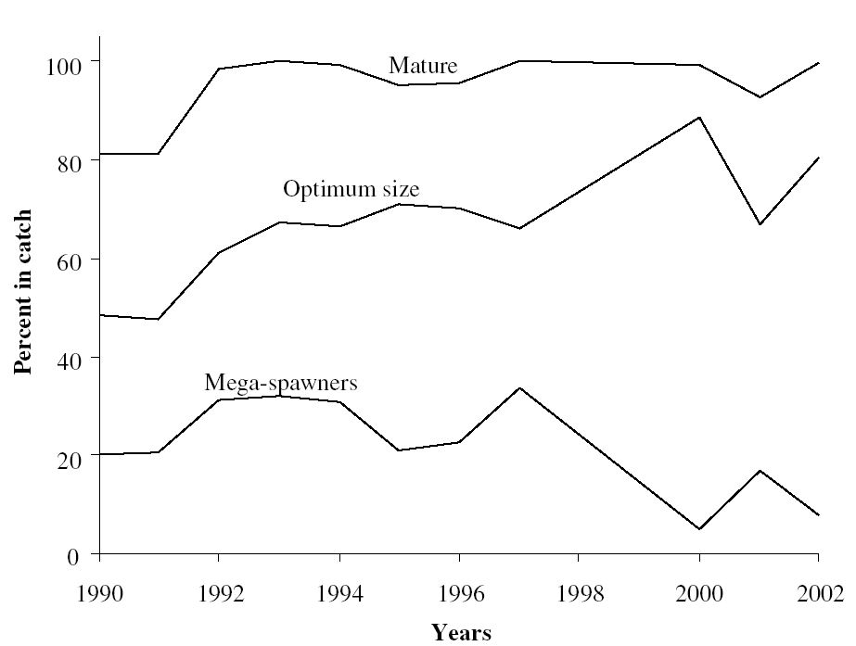
Length-based reference points (LtRPs)
Length composition
Proportion through time
Frequency
Proportion
Length bin
Year
L_{max} = max length
L_{opt} = length at max biomass
L_{mat} = length at maturity
Froese 2004
Notes:
Froese in 2004 suggested a simple way of going about assessing a stock using only length compositions from catches.
This idea has gained traction in the literature, so I decided to take a closer look at it.
Let’s define the idea.
Popt is based on the idea that there is a length that maximizes biomass.
This approach aims to avoid both growth and recruitment overfishing while maintaining high yield.
Let’s take a look at the approach and define each measure.
Explain the change in values through time.
One major advantage is that no baseline measures are needed.

Slide 11
LBRP Decision Tree: Stock status (adding complexity)
P_{obj}= P_{mat} + P_{opt} + P_{mega}
P_{obj} <1
1< P_{obj} <2
P_{obj} = 2
P_{opt} + P_{mega}= 0
P_{opt} + P_{mega}> 0
P_{opt} < 1
P_{opt} = 1
If L_{mat}<0.75L_{opt} and P_{mat}>0.4, SB>RP
If L_{mat}<0.75L_{opt} and P_{mat}>0.95, SB>RP
P_{mat}>0.25, SB>RP
P_{opt}<0.65, SB>RP
No status information
or
or
If L_{mat}=0.9L_{opt} and P_{mat}>0.25, SB>RP
If L_{mat}=0.9L_{opt} and P_{mat}>0.90, SB>RP
Cope and Punt 2009
Notes:
This decision tree illustrates how one would apply the new Pobj value in conjunction with the proportional measures of Froese to obtain information on stock status.
Let’s follow one branch of the tree (small fish)
You can then do this for a range of selectivities to get status information.
This indicates the taking of plate-sized immature fish is only sustainable at very low F values, but one may be able to track the effect through these proportions.

Slide 12
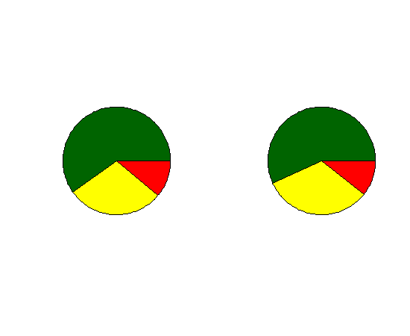
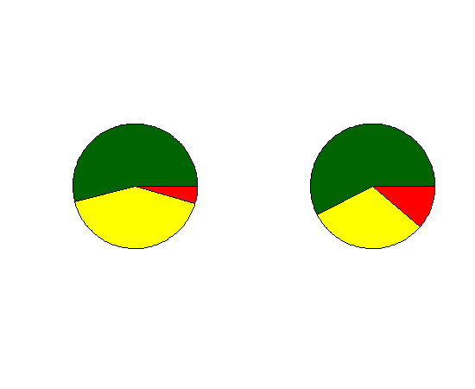
Groundtruthing LBRPs against stock assessments
Methods
Results
Apel et al. in prep.
9 stocks
All years with Lt. comps (>24 yrs)
Reference points
Target (SB_{40%})
Limit (SB_{25%})
F_{MSY}
Status
Overfishing
TRP
Agree
LRP
Precautionary
Risky

Slide 13
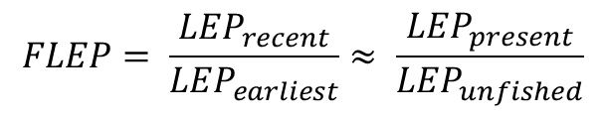

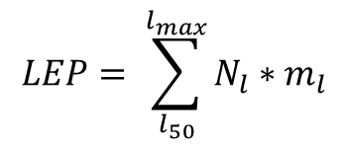



Fractional Change in Lifetime Egg Production (FLEP)
$$LEP= \sum_{l_{50}}^{l_{max}}{N_{l}∗m_{l}}$$
$$N_{l}=Number at length l$$
$$l_{50}=length at 50\% maturity$$
$$m_{l}=fecundity at length l$$
$$l_{max}=maximum length$$
$$FLEP= \frac{{LEP}_{recent}}{{LEP}_{earliest}}≈ \frac{{LEP}_{present}}{{LEP}_{unfished}}$$
O’Farrell and Botsford 2005

Slide 14
Length-Based SPR Assessment
Hordyk et al. 2015

Slide 15
(Very) Data-Limited Fisheries
No surveys
No index of abundance
No catch or effort records
No age composition
Is it possible to use basic information on the life history parameters to assess data-poor stocks?

Slide 16
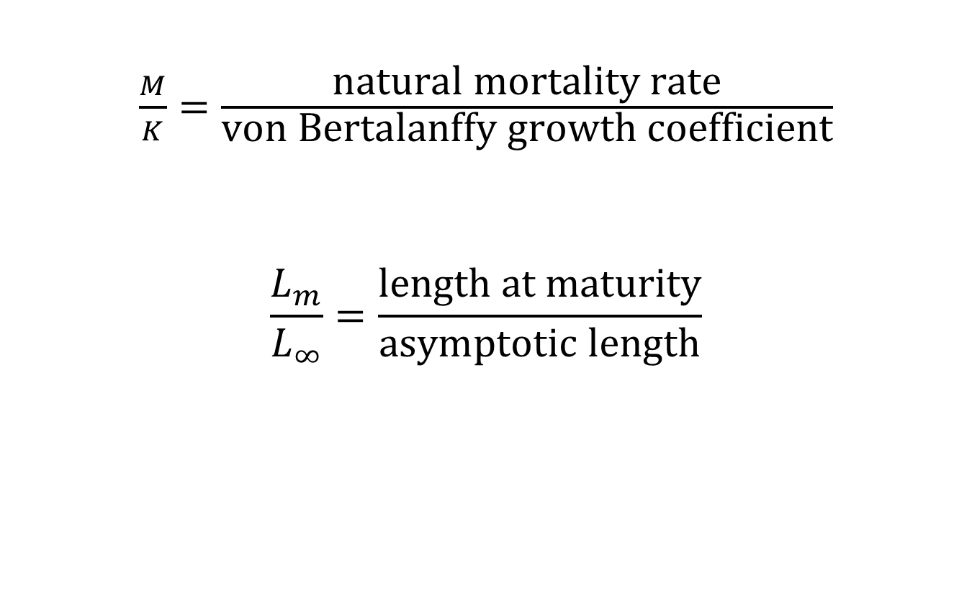
Life History Ratios
$\frac{M}{K}=\frac{\text{natural} \text{mortality} \text{rate}}{\text{von} \text{Bertalanffy} \text{growth} \text{coefficient}}$
$$\frac{L_{m}}{L_{∞}}=\frac{\text{length} \text{at} \text{maturity}}{\text{asymptotic} \text{length}}$$

Slide 17
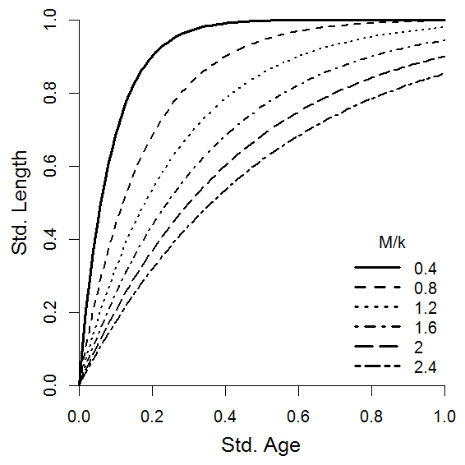
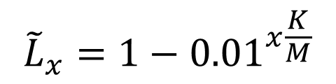
M/K and standardised vB curve
$${\tilde{L}}_{x}=1−{0.01}^{x\frac{K}{M}}$$
Standardised von Bertalanffy growth curve

Slide 18
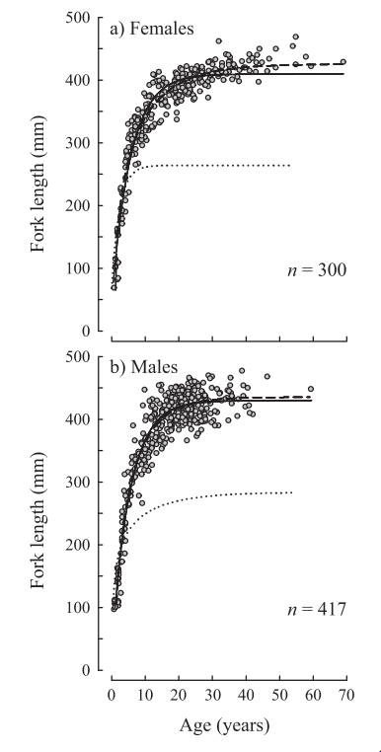
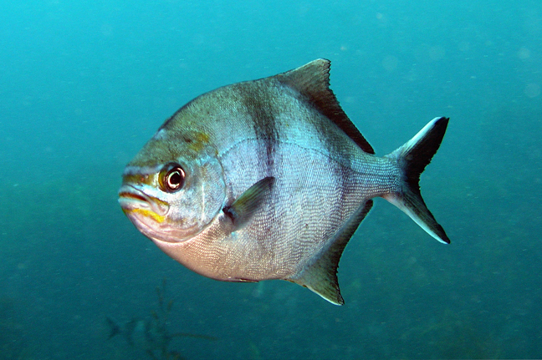
M/K and standardised vB curve
Female
M/K = 0.33
L∞ = 405 mm
M = 0.06
K = 0.18
Scorpis aequipinnis
Sea Sweep Kyphosidae
Western Australia
L∞
Male
M/K = 0.38
L∞ = 429 mm
M = 0.07
K = 0.18
Lightly exploited
Coulson et al. 2012 Fisheries Research

Slide 19
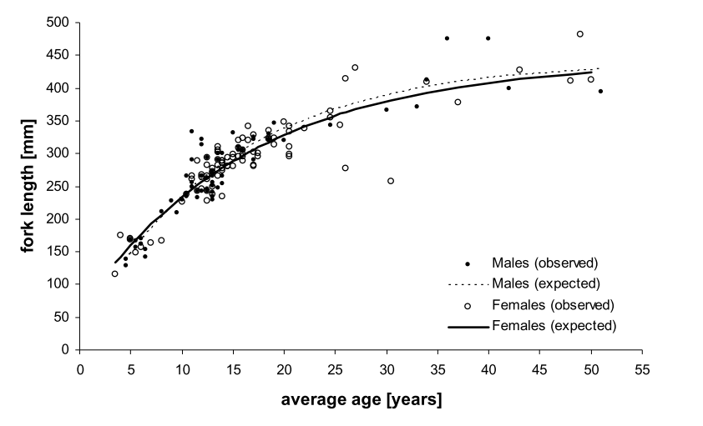
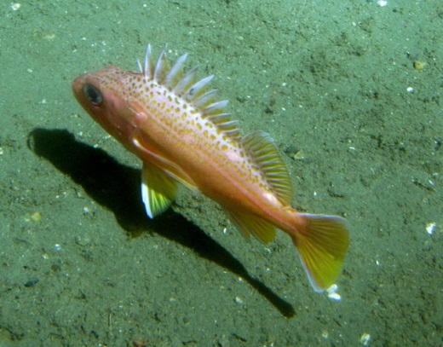

M/K and standardised vB curve
$$L_{∞}$$
Sebastes chlorostictus
Greenspotted rockfish
California
M/K = 0.97
L∞ = 457 mm
M = 0.06
K = 0.062
Lightly exploited
Benet et al. 2009 NOAA

Slide 20
M/K and Expected Unfished Size Composition
Assumptions:
Equilibrium conditions
Continuous growth and reproduction
Growth described by vB
Length-at-age normally distributed

Slide 21
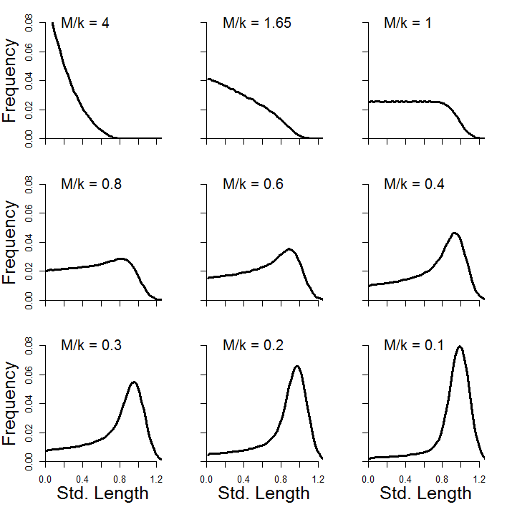
M/K and Expected Unfished Size Composition
High M/k
Few survive to asymptotic size
Low M/k
Pop. Dominated by large fish

Slide 22
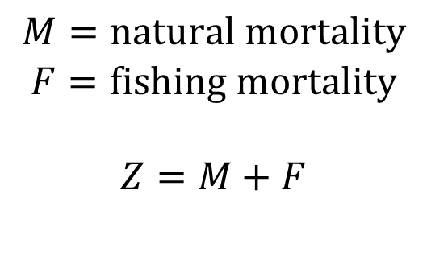
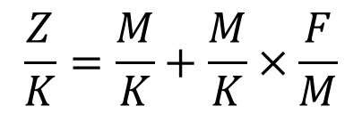
Z/K and Expected Unfished Size Composition
$$M=\text{natural} \text{mortality}$$
$$F=\text{fishing} \text{mortality}$$
$$Z=M+F$$
$$\frac{Z}{K}=\frac{M}{K}+\frac{M}{K}×\frac{F}{M}$$
M/K → unfished size composition
Z/K → fished size composition

Slide 23
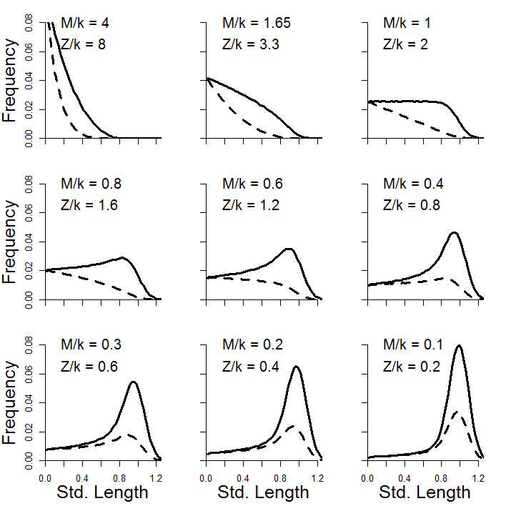
Z/K and Expected Unfished Size Composition
All selected
F/M = 1

Slide 24
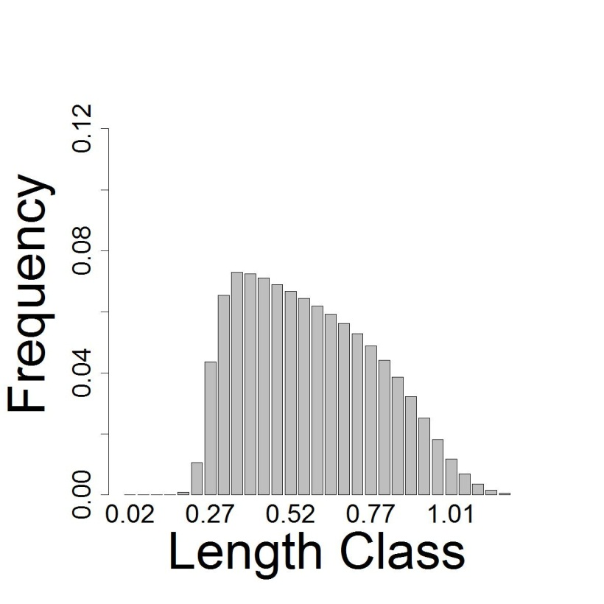
Length-Based SPR Assessment
Knowledge of M/K
From meta-analysis, literature, comparative studies, etc.
M/K often more stable between stocks/species than individual parameters (Beverton, 1992)
Predict unfished
size composition
Standardised to L∞

Slide 25
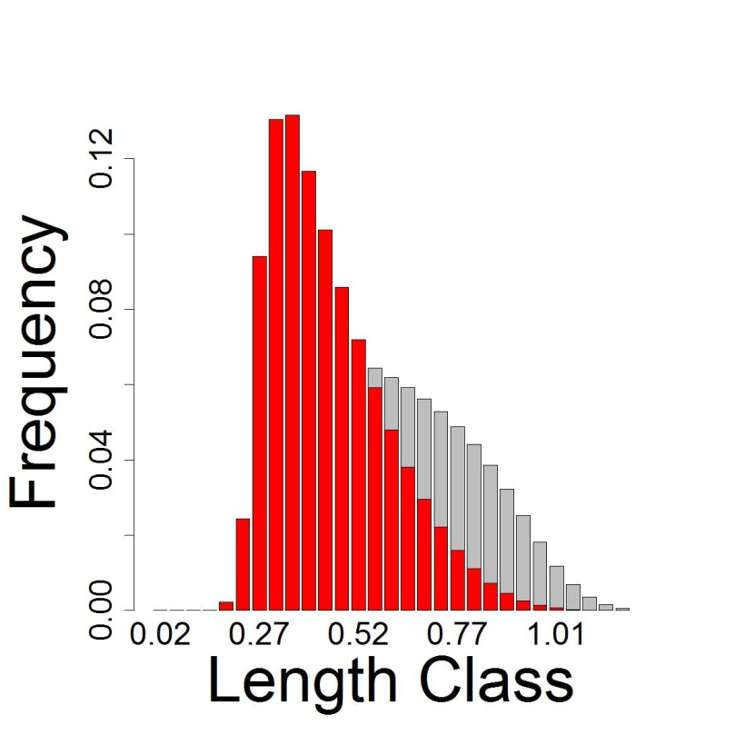
Length-Based SPR Assessment
Difference caused by fishing mortality (F/M)
Observed size composition of catch →
Standardised to L∞

Slide 26
Length-Based SPR Assessment
Model input: M/K, L∞, CV_{L∞}, maturity-at-size & length composition of catch
CV_{L∞} = variability of length at max. age (assumed constant CV of 0.1)
Model output: Estimate selectivity and F/M
Calculate the Spawning Potential Ratio (SPR)

Slide 27
Spawning Potential Ratio
Fraction of unfished egg production
Takes values from 0 (no spawning) to 1 (unfished stock)
Reference points directly related to ‘steepness’ of SRR
SPR 0.4 often used as Target Reference Point
SPR 0.2 often used as Limit Reference Point

Slide 28
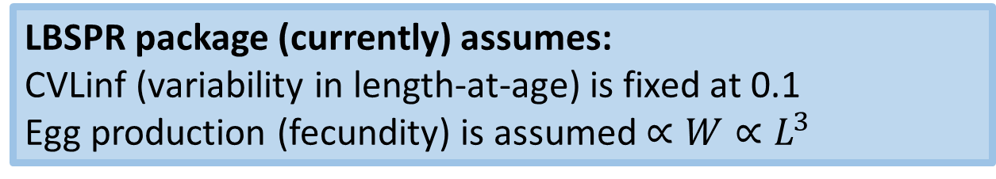
Length-Based SPR Model
Standard Assumptions:
Equilibrium model (with all the associated problems)
Length data representative of exploited stock (selectivity estimated from catch data)
Asymptotic selectivity (large fish absent from the catch are assumed caught)
Length-at-age normally distributed (in unfished conditions)
Fixed K and M (M can be size-dependant)
LBSPR package (currently) assumes:
CVLinf (variability in length-at-age) is fixed at 0.1
Egg production (fecundity) is assumed $∝{W∝L}^{3}$

Slide 29
Two Approaches
Age Structured LBSPR (Hordyk et al 2015)
Discrete age-based model
Large number of pseudo ‘age classes’ – continuous growth
Possible Issues with Model
Selectivity is age-based:
Length-at-age normally distributed – not affected by exploitation
Large fish still expected at high F
Faster growing fish reach selected size at younger age
Consequence: over estimates F if selectivity is size-dependant

Slide 30
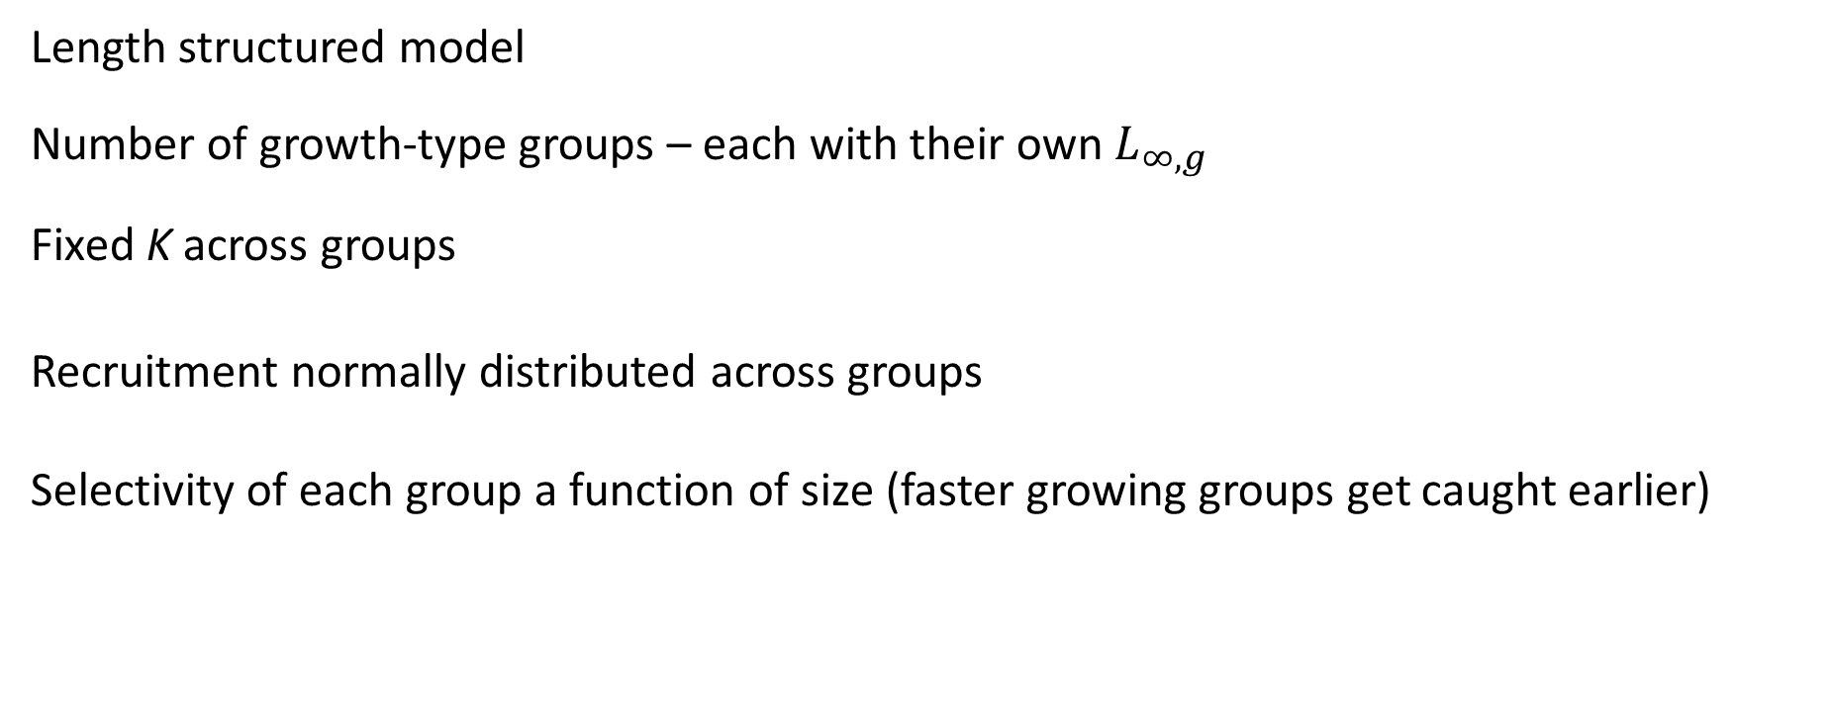
Two Approaches
Length Structured GTG (Hordyk et al 2016)
Length structured model
Number of growth-type groups – each with their own $L_{∞,g}$
Fixed K across groups
Recruitment normally distributed across groups
Selectivity of each group a function of size (faster growing groups get caught earlier)
Estimates a lower F/M (and higher SPR) compared to age-based selectivity for given size structure because of the ‘regeneration assumption’ in the age-based model

Slide 31
LBSPR R Package
LBSPR simulation, estimation, and plotting functions,
Early version – there may be bugs or random crashes! (let me know)
Vignette and demo data files
Online R Shiny App
LBSPR methods included (almost) in the DLMtool (R package from MSE for data-limited fisheries)
See attached R code for demo of the LBSPR package

Slide 32
References
Hordyk, A.R., Ono, K., Valencia, S.R., Loneragan, N.R., and Prince, J.D. 2015. A novel length-based empirical estimation method of spawning potential ratio (SPR), and tests of its performance, for small-scale, data-poor fisheries. ICES J. Mar. Sci. 72: 217–231.
Hordyk, A.R., Ono, K., Sainsbury, K.J., Loneragan, N., and Prince, J.D. 2015. Some explorations of the life history ratios to describe length composition, spawning-per-recruit, and the spawning potential ratio. ICES J. Mar. Sci. 72: 204–216.
Hordyk, A., Ono, K., Prince, J.D., and Walters, C.J. 2016. A simple length-structured model based on life history ratios and incorporating size-dependent selectivity: application to spawning potential ratios for data-poor stocks. Can. J. Fish. Aquat. Sci. 13: 1–13. doi: 10.1139/cjfas-2015-0422.
Prince, J.D., Hordyk, A.R., Valencia, S.R., Loneragan, N.R., and Sainsbury, K.J. 2015. Revisiting the concept of Beverton–Holt life-history invariants with the aim of informing data-poor fisheries assessment. ICES J. Mar. Sci. 72: 194–203.

Slide 33
Catch-Curve Stock Reduction Analysis
Stock Reduction Analysis
Catch time series and natural mortality
Initial population abundance, and depletion between first and last years
Estimates fishing mortality rates for all years and an annual recruitment rate, R.
Works well if estimate of depletion is a good one.

Slide 34
Catch curves
Uses age or length composition
Auxiliary information regarding life history
Estimates fishing mortality rate
Selectivity parameters
Annual recruitment
Natural mortality given a prior

Slide 35
Catch-curve stock reduction analysis
Replaces the need for a depletion estimate with the age/length composition.

Slide 36
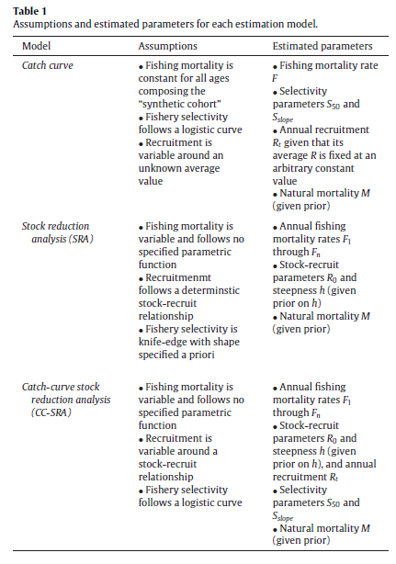

Slide 37
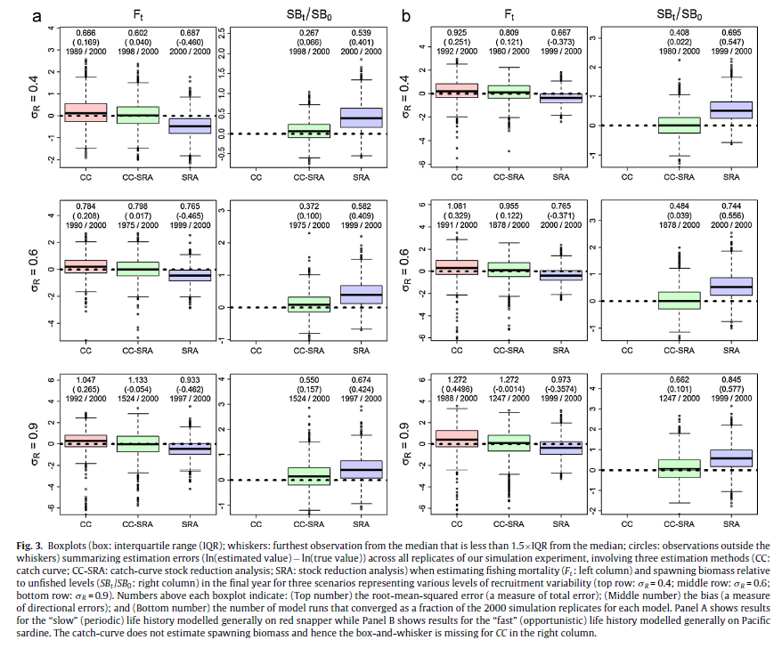

Slide 38
Back to the computers

